Slide 1



DESIGN AND ANALYSIS
OF ALGORITHMS

Slide 2
DESIGN AND ANALYSIS OF ALGORITHMS
Decrease by Variable size Algorithm

Slide 3
DESIGN AND ANALYSIS OF ALGORITHMS
Variable Decrease and Conquer
The third principal variety of decrease-and-conquer, the size reduction pattern varies from one iteration of the algorithm to another.
This algorithm helps optimize:
Computing a Median and the Selection Problem
Interpolation Search
Searching and Insertion in a Binary Search Tree
The Game of Nim
We will look at Computing a Median and the Selection Problem in detail.

Slide 4
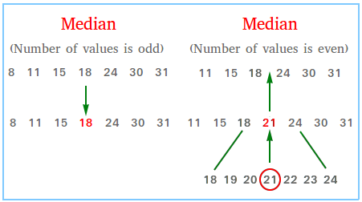
DESIGN AND ANALYSIS OF ALGORITHMS
Variable Decrease and Conquer
Computing a Median and the Selection Problem
Objective: Find the median of an odd array in the best time.
What is the Median?
The median is the middle value of a sorted
array.
Naïve Approach:
Sort the array.
Find the element in the middle position.
Time complexity:
Sorting: O(n log n)
Selecting the middle element: O(1)
Total: O(n log n)

Slide 5
DESIGN AND ANALYSIS OF ALGORITHMS
Variable Decrease and Conquer
Computing a Median and the Selection Problem
Issues with the Naïve Approach:
Sorting places all elements in their correct positions.
We only need the middle element, so sorting the entire array is unnecessary.
What can be optimized:
Instead of sorting all elements, directly try to find the element at the n/2 position.
This problem of finding the k-th smallest or largest element is called the Selection Problem.
Proposed Solution:
QuickSelect to solve the Selection Problem

Slide 6
DESIGN AND ANALYSIS OF ALGORITHMS
Variable Decrease and Conquer
Computing a Median and the Selection Problem
Quick Select:
Similar to Quick Sort, we pick a pivot element and partition the array:
Elements smaller than the pivot go to the left.
Elements larger than the pivot go to the right.
The pivot is placed in its correct position.
This partition technique is called Lomuto Partition.
Difference from Quick Sort:
Quick Sort recursively sorts the entire array.
Quick Select stops once the pivot is at the k-th position (n/2 for median).

Slide 7
DESIGN AND ANALYSIS OF ALGORITHMS
Variable Decrease and Conquer
Algorithm for QuickSelect
Input : List, left is first position of list, right is last position of list and k is k-th smallest element.
Output : A new list is partitioned.
quickSelect(list, left, right, k)
if left = right
return list[left]
// Select a pivotIndex between left and right
pivotIndex <= partition(list, left, right, pivotIndex)
if k = pivotIndex
return list[k]
else if k < pivotIndex
right <= pivotIndex - 1
else
left <= pivotIndex + 1

Slide 8
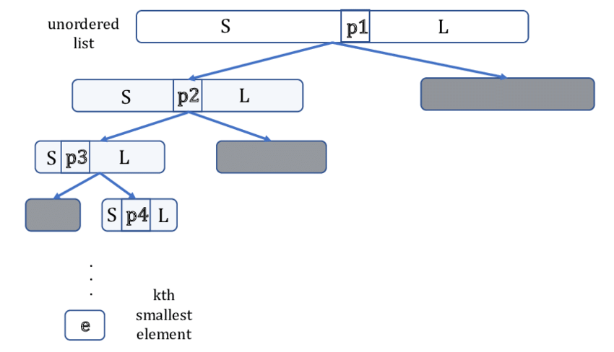
DESIGN AND ANALYSIS OF ALGORITHMS
Variable Decrease and Conquer
QuickSelect

Slide 9
Find the 5th smallest element in the given array
l
k= 4th index
r
0 1 2 3 4 5 6 7 8
pivot(first element) = 4
4
1
10
8
7
12
9
2
15
S
p
L
1
2
4
10
8
7
12
9
15
p<k, repeat for right array
p<k, repeat for right array
pivot(first element) = 10
1
2
4
10
8
7
12
9
15
S
p
L
1
2
4
8
7
9
10
12
15
p>k, repeat for left array
pivot(first element) = 10
1
2
4
8
7
9
10
12
15
S
p
L
1
2
4
7
8
9
10
12
15
5th smallest element is 8

Slide 10
DESIGN AND ANALYSIS OF ALGORITHMS
Variable Decrease and Conquer
Time Complexities for QuickSelect
Best Case:
The best case occurs when the pivot chosen is always the median of the array. This perfectly divides the array in half at each step.
The recurrence relation: T(n)=T(n/2)+O(n)
Solving this gives O(n) time complexity, and the problem size is reduced exponentially.
Worst Case:
The worst case occurs when the pivot selection is poor, e.g., always choosing the smallest or largest element. This results in highly unbalanced partitions, where one side has n - 1 elements and the other has 0.
The recurrence becomes: T(n)=T(n−1)+O(n)
Solving this gives O(n²) time complexity.

Slide 11
DESIGN AND ANALYSIS OF ALGORITHMS
Variable Decrease and Conquer
Improve the Worst Case Complexity
There are two key ways to achieve better worst-case complexity:
Choosing a Better Pivot Selection Strategy such as Median of Medians Algorithm.
Using an Improved Partitioning Algorithm such as using Hoare’s Partition Scheme instead of Lomuto’s Partition Scheme can improve efficiency by reducing swaps.
Median of Medians Algorithm (Guaranteed O(n) Worst-Case):
We need to choose a pivot close to the median consistently. This ensures better partitioning and prevents highly unbalanced cases.
Divide the array into groups of 5 elements (or another small fixed size).
Find the median of each group.
Recursively find the median of these medians to use as the pivot.
Ensures a pivot that is reasonably close to the true median, avoiding worst-case O(n²).
Guarantees O(n) worst-case time complexity.

Slide 12
DESIGN AND ANALYSIS OF ALGORITHMS
Variable Decrease and Conquer
By utilizing variable-size Decrease and Conquer, we optimized the Selection Algorithm, making median computation more efficient.
Unlike traditional divide-and-conquer, where the problem size is reduced by a fixed factor (e.g., halving in binary search), variable-size reduction allows for adaptive problem shrinking at each step. In Quick Select, this means:
Instead of processing the entire array, we eliminate a portion based on the pivot's position.
The size reduction varies dynamically, depending on where the pivot is placed.
This flexibility enables an O(n) average-time complexity, significantly improving over naive sorting methods.
By using variable Decrease and Conquer, we were able to directly target the element we needed, making the solution far more efficient.

Slide 13

THANK YOU

